Slide 1
Lenses and Polarization
Colours? Only 36 Slides

Slide 2
Polarization

Slide 3
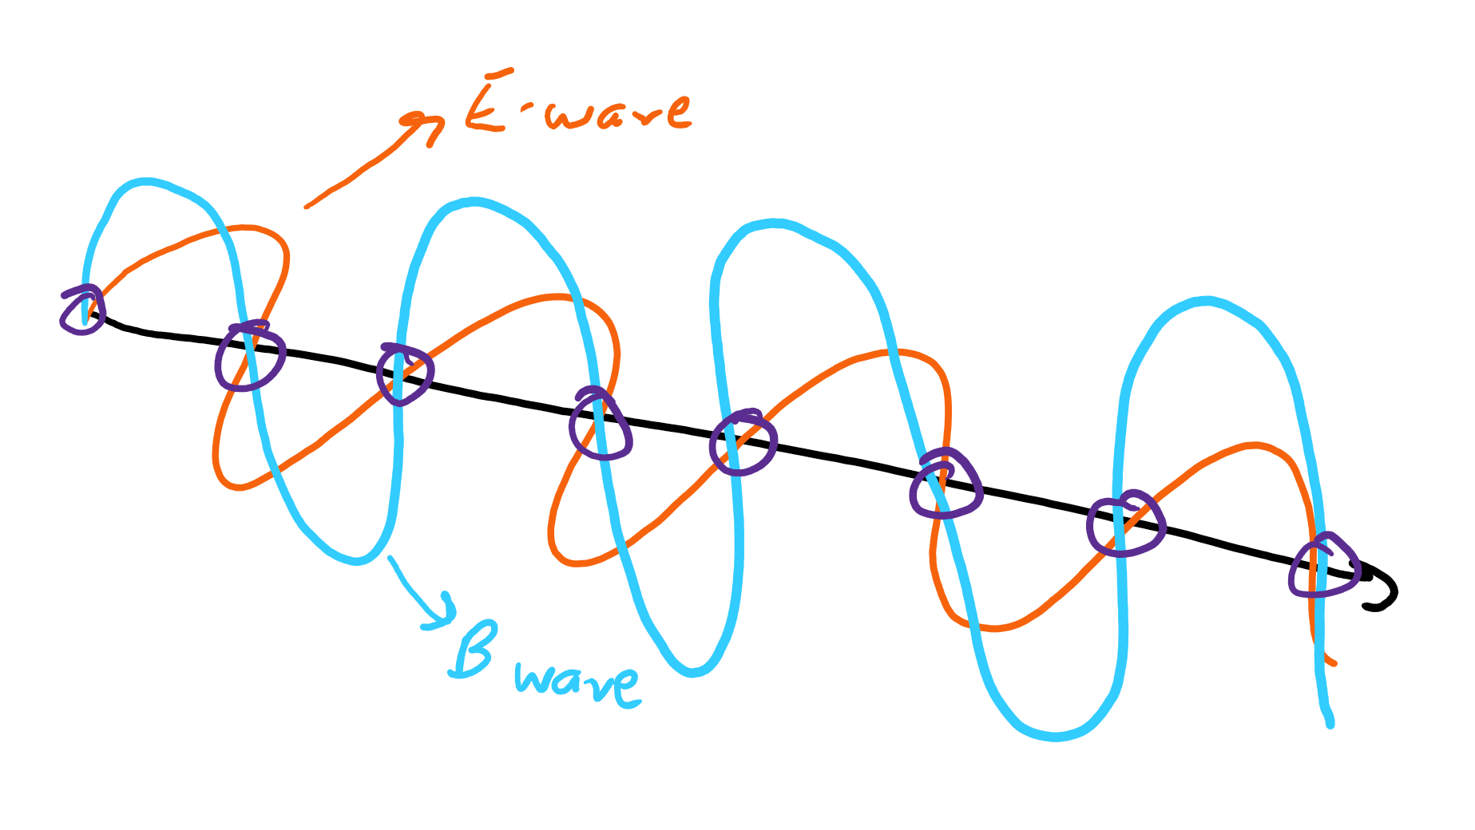
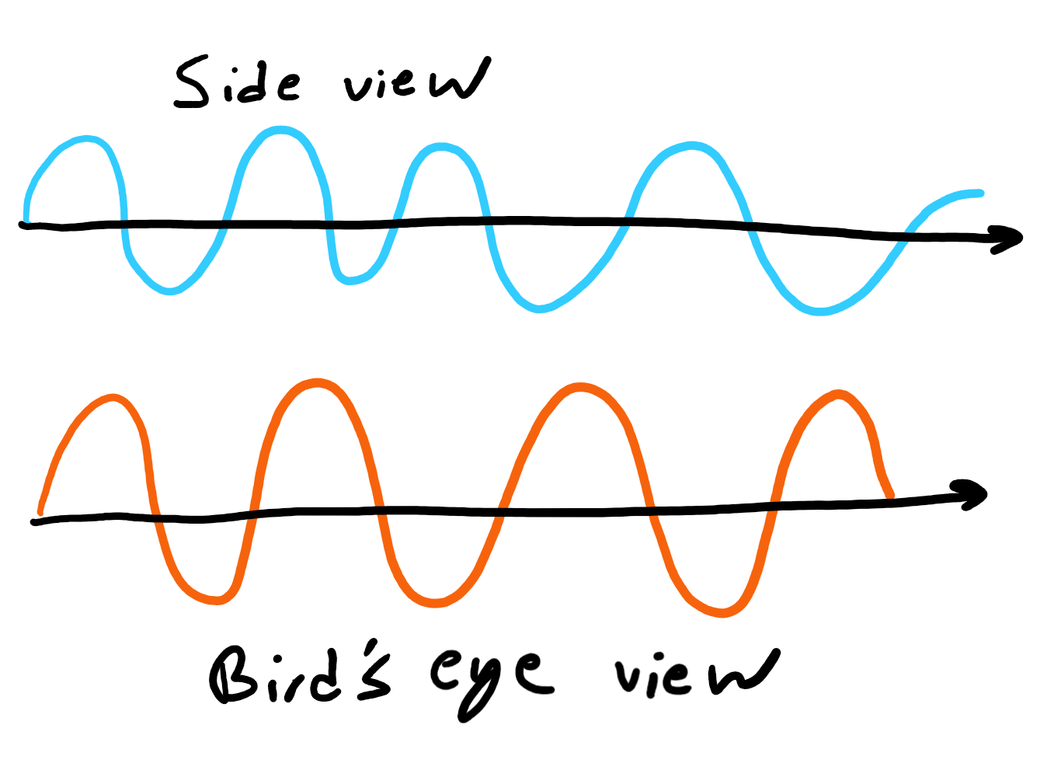
What does light look like?
Electromagnetic wave:
Combination of, well, electric and magnetic waves
They’re perpendicular to each other
Constantly destroying and creating itself
In purple are the places the “wave destroys itself”

Slide 4
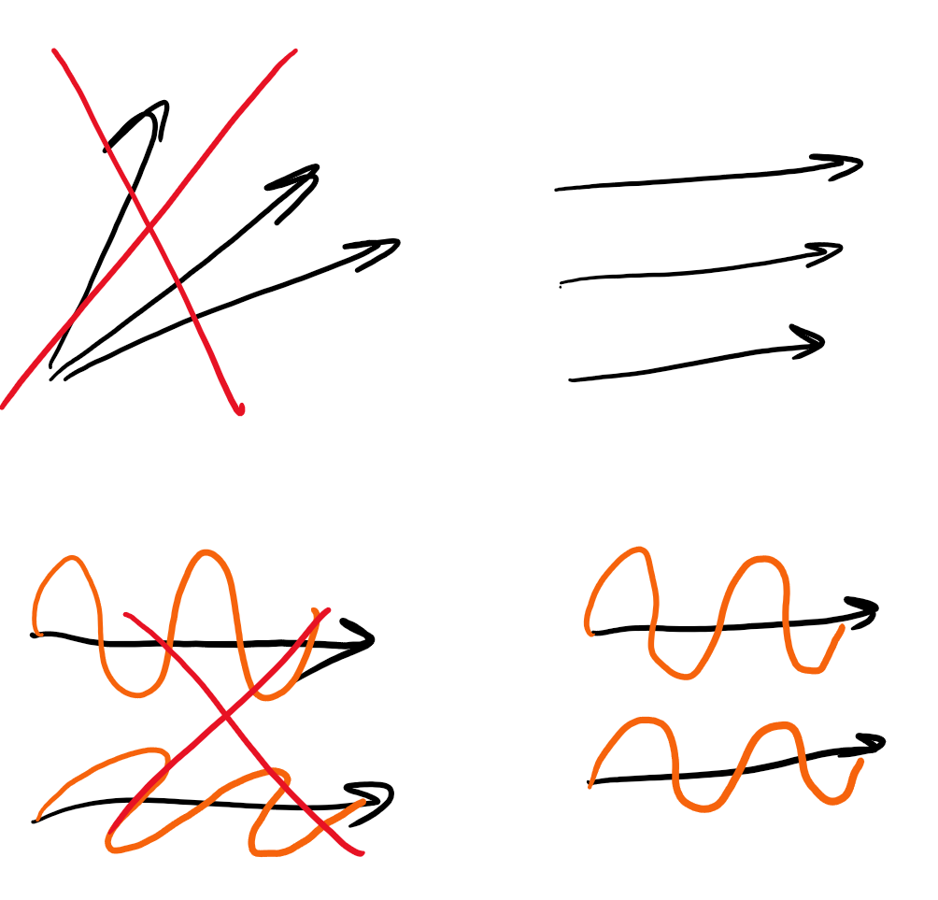
Polarization?
What is Polarization?
“Polarized light waves are light waves in which the vibrations occur in a single plane”
All the light travels in the same direction
All the electric fields are oriented the same way

Slide 5
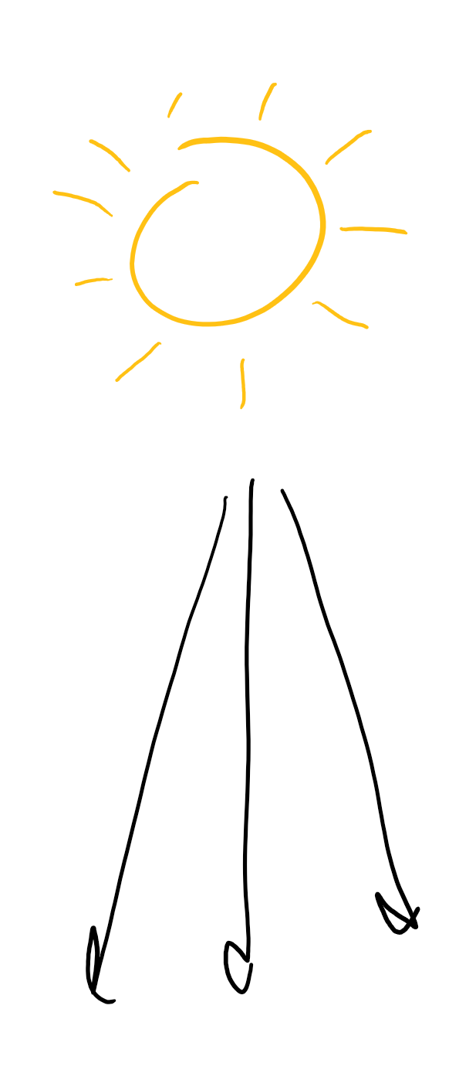
Polarization 2 electric boogaloo
What does it mean?
What is light normally like?
What if it’s polarized?
What are some examples of non-polarized light?
Sun
Most light sources

Slide 6
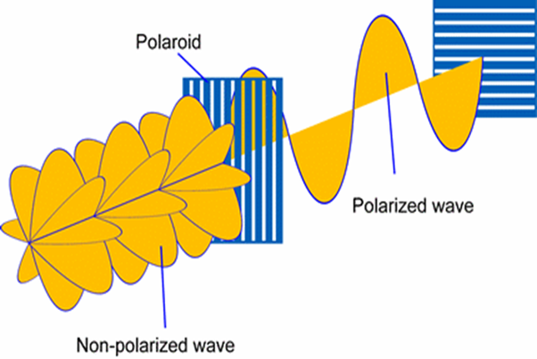
Where does Polarized light come from? Part 1
Polaroids:
Diffraction gratings
Block light in a specific orientation
Reflection
Non-Metallic Reflections Polarize Light
Snow
Roads
Water

Slide 7
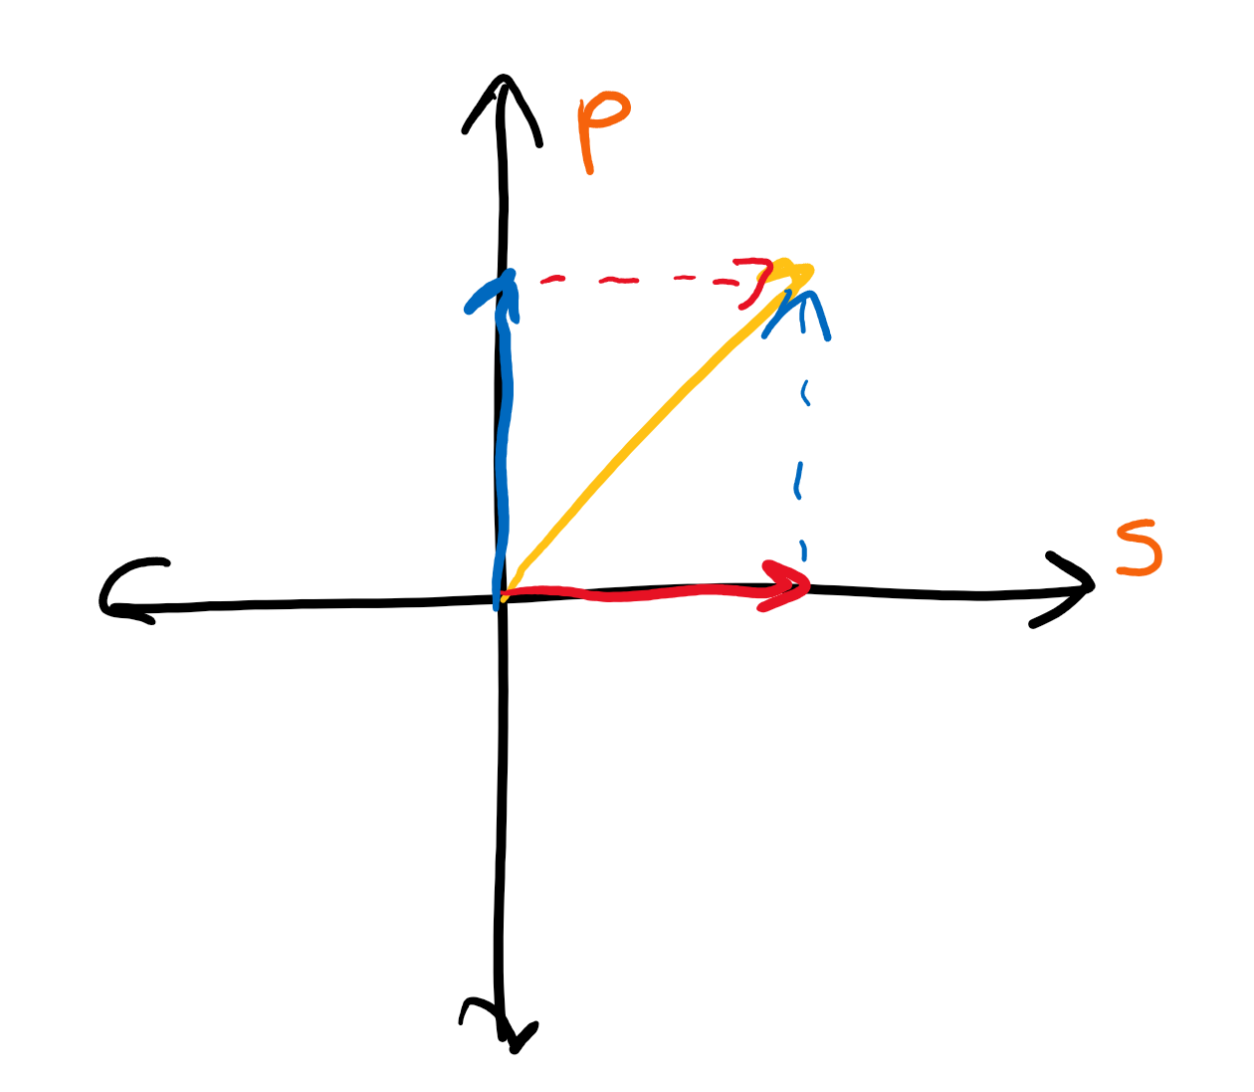
Types of polarization
S-polarized
Polarization parallel to the “surface”
P-polarized
Polarization perpendicular to the “surface”
P and S are perpendicular to each other

Slide 8
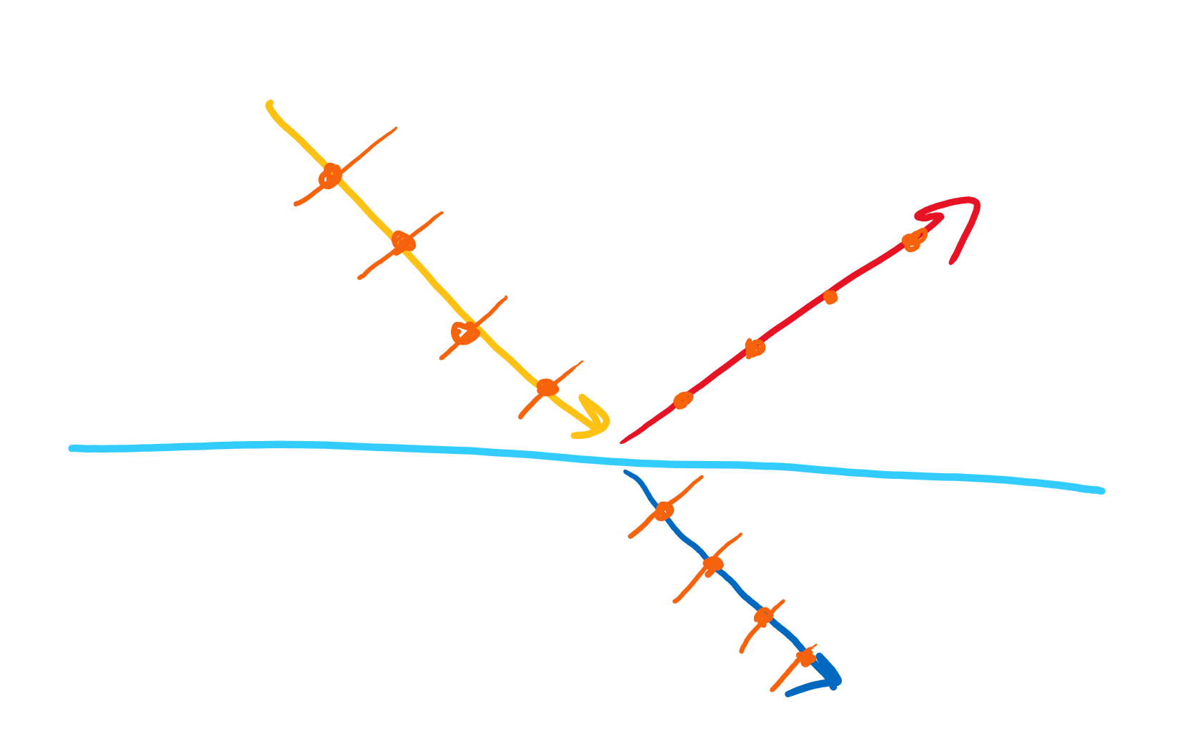
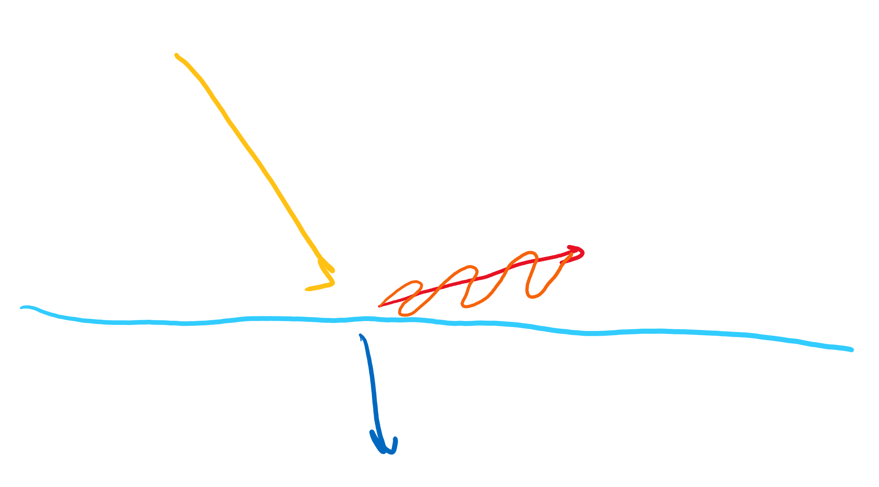
Where does Polarized light come from? Part 2
Refraction/Reflection:
Brewster’s angle extended
Refracted ray is Perpendicular to reflected ray
Causes perfect Polarization

Slide 9
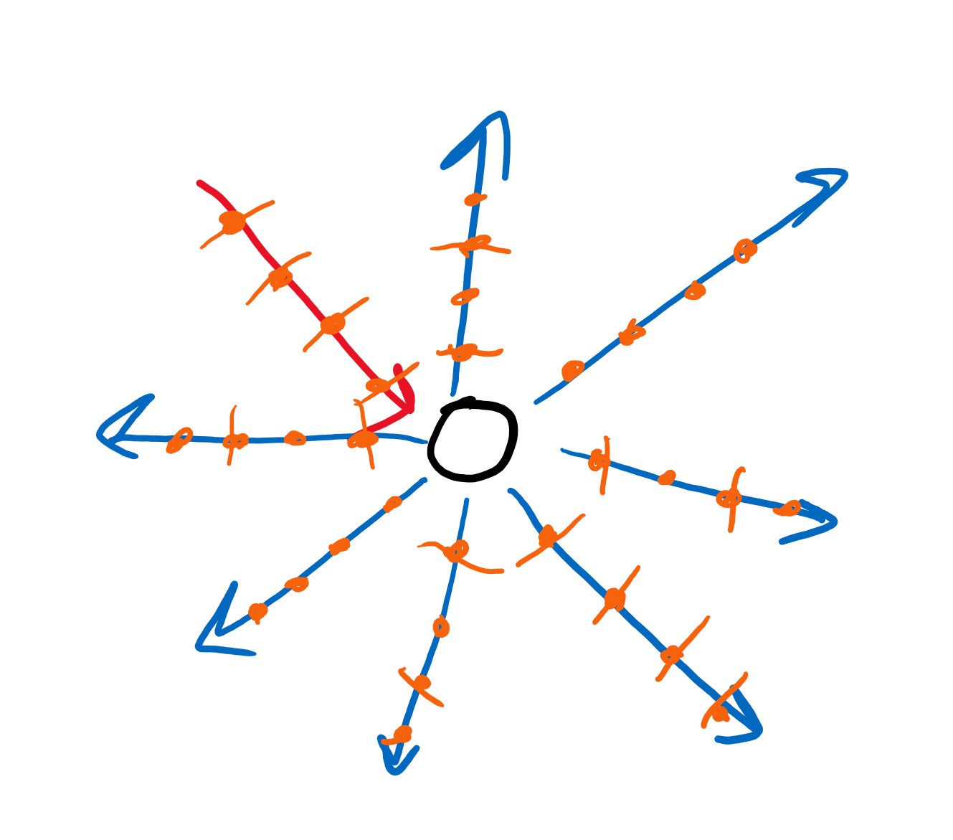
Where does Polarized light come from? Part 3
Scattering:
Only Partially Polarized
Particles will re emit light in certain orientations
Causes glare when looking at sky
Cameras and polaroid filters

Slide 10
Uses?
Some uses of polarization are:
Decreasing intensity by a controllable amount:
Sunglasses
What happens if 2 filters block light perpendicularly?
Reduction of Glare
Glare is caused by polarized light, so Polaroid filters lessen glare
Helps see where transparent materials are most fragile
Filters on a protractor will see bands which are weaker
3D movies?

Slide 11
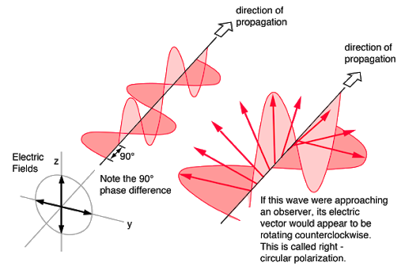
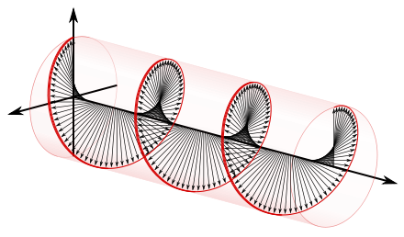
Circular polarization?
Interference can cause the polarization to spin in a circle, either clockwise or counterclockwise
3D glasses can also use circular polarization
Left eye sees clockwise
Right sees counterclockwise
Or vice-versa

Slide 12
Interesting effects
Take light and pass it through a polaroid
Set another polaroid at a 45 degree angle to it
Set a third at a 45 angle to the previous one
The first and the third are 90 degrees off, so no light should pass right?
Wrong! The 45 degree polaroid made it so the light can actually pass through! Another barrier increased the light that passed through!

Slide 13
Review
What is polarization?
Where does non-polarized light come from?
Where does polarized light come from?
What are some of its uses?
What happens if we have 2 filters at a 90 degree angle to each other and pass light through both of them? What if we add a filter between at 45 degrees?

Slide 14
Colors

Slide 15
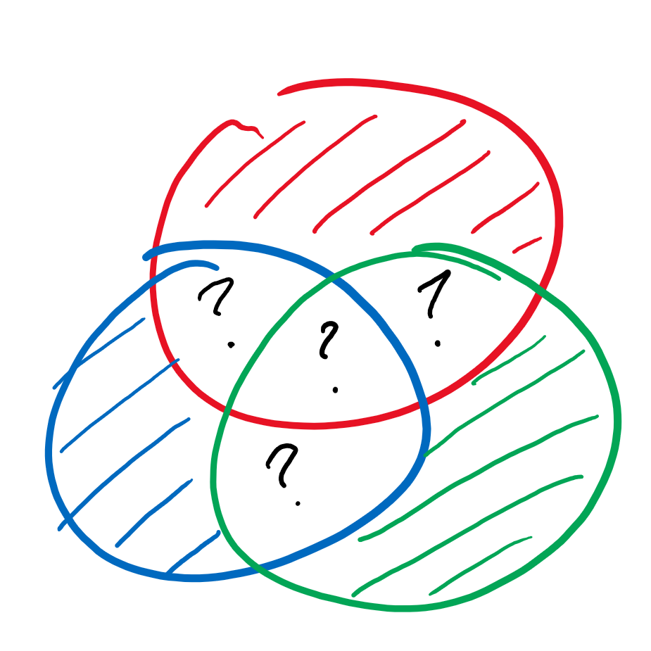

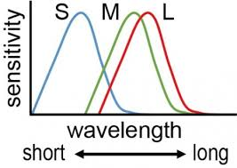
Primary colors?
Our eyes have “rods” and “cones”
Rods detect how “bright” something is
Amplitude
Different colors excite different zones in cones, can you guess which colors?
Red, blue, green

Slide 16
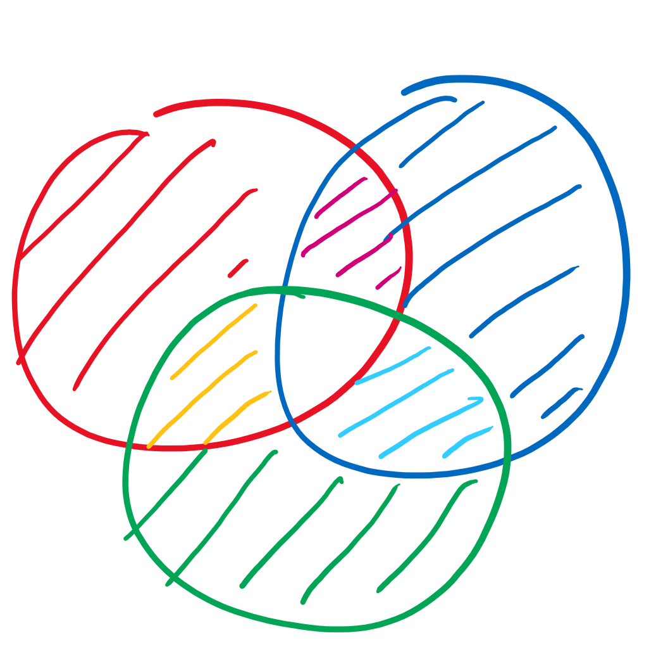
When colors interact
All colors together make white!
Any two “primary” colors of light make a “primary” color of paint
Why?
What color do we get when we take away red from white?
What if we took away blue?
Green?

Slide 17
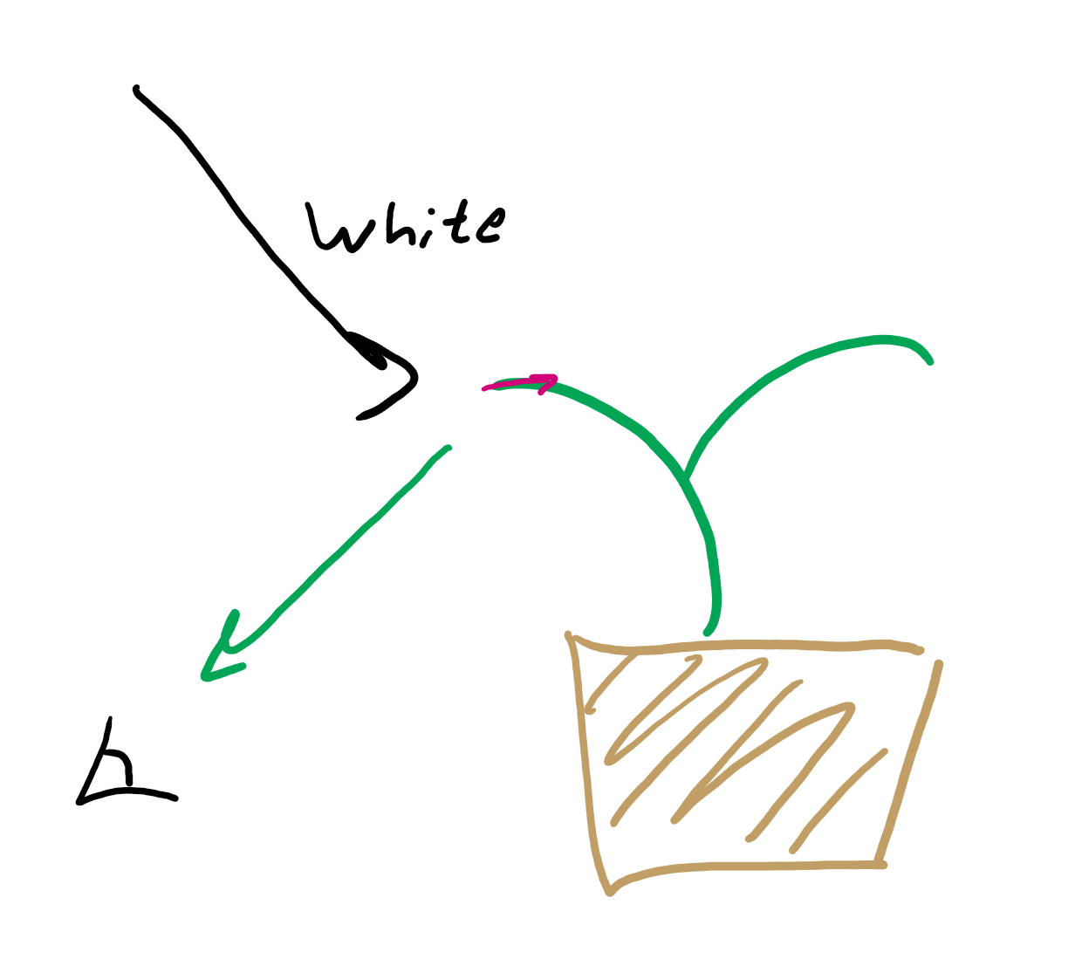
Why we see color
Objects absorb or reflect different amounts of light.
We only see the light that’s reflected back at us.

Slide 18
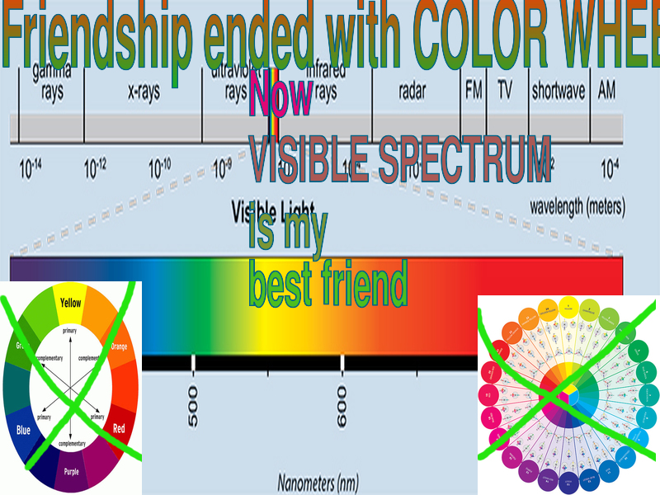
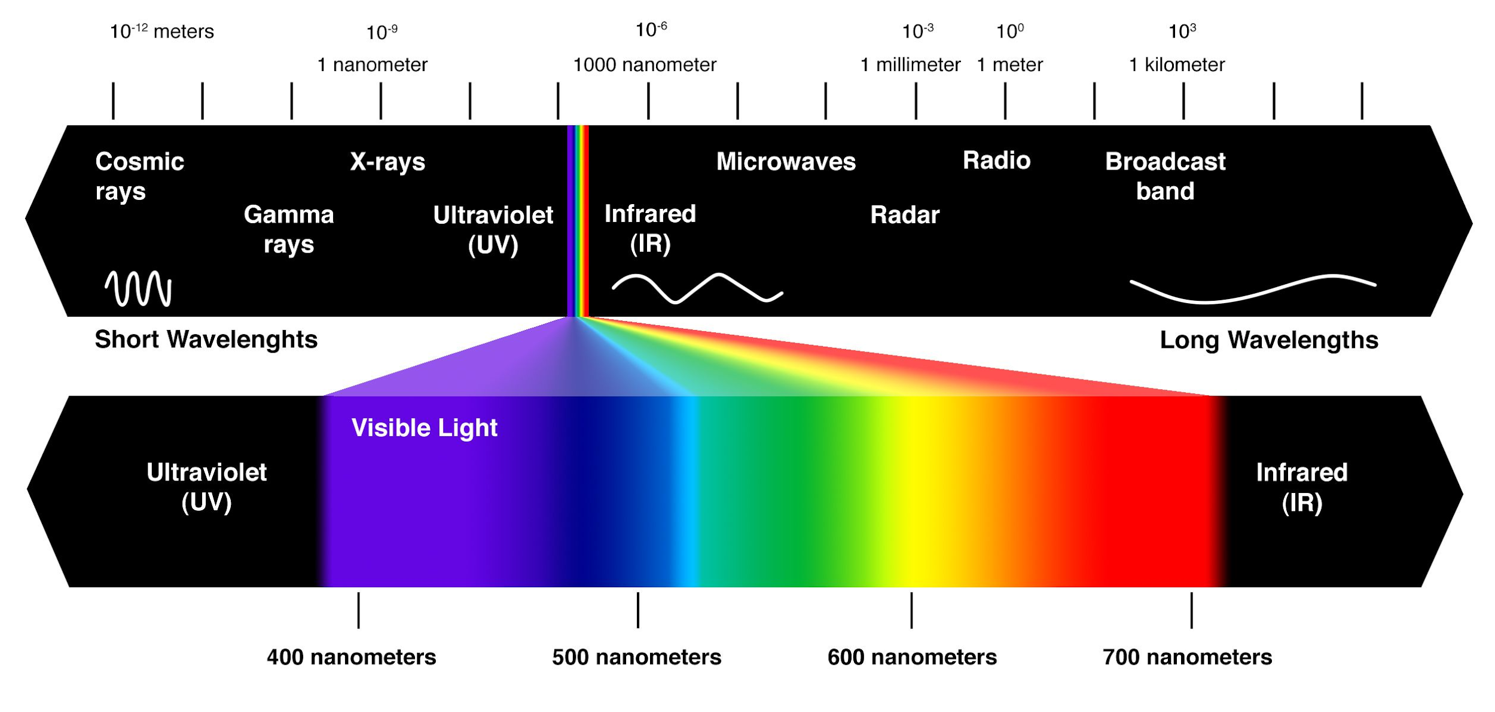
Purple is a fake color hmph
Your art class lied to you; color doesn’t exist in a wheel
“Purple” is just what our brain tells us we see when violet and red light interact

Slide 19
Lenses

Slide 20
What is a Lens?
What are some lenses that you know?
Glasses
Magnifying glass
Camera Lenses
Contact Lenses
What is lens?
“A lens is a piece of transparent material that is shaped so as to cause light rays to bend in a specific way as they pass through it, whether that means making the rays converge to a specific point or to diverge as if from a specific point.”

Slide 21
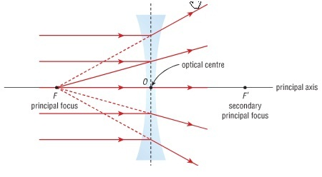
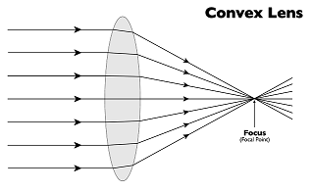
Focus?
“A focus, also called an image point, is the point where light rays originating from a point on the object converge”
Where all the light goes to
Causes Magnifying glasses to create fires
Can also be a point where light doesn't go to

Slide 22
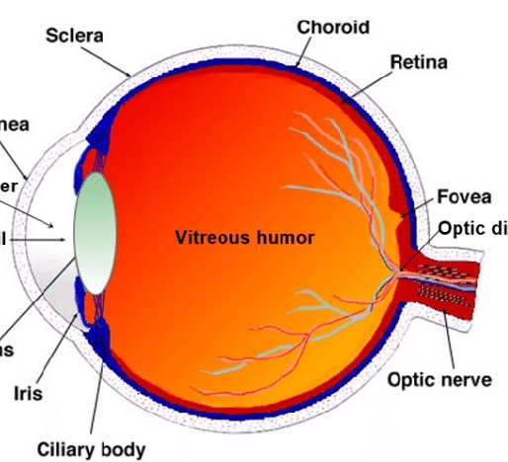
Example Analysis
Glasses:
Light should be focused by Cornea and Lens (the part of the eye is actually called lens) onto the Retina
If any of those doesn't work properly, glasses help focus light on the retina
Magnifying glass:
Focus the object so it looks at its largest before the focus
Cameras:
Focus the light on a single point- Better Image

Slide 23
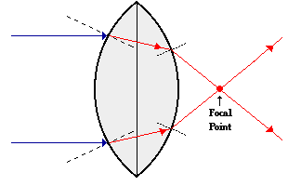
Why?
Any guesses?
Refraction!!!
Light refracts due to the glass surface
They change its direction so all light goes to one point
Although to refract the lens needs thickness…
Assume they are infinitely thin but still focus light
This is perfect physics world :)

Slide 24
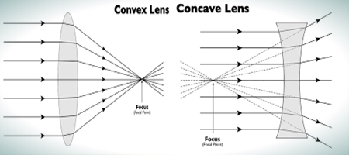
Types of Lenses
Concave:
Glasses
Magnifying Glass
Focus is on the opposite side of object
What does that mean?
Convex:
Microscopes
Telescopes
Focus is on the same side as the object
What does that mean?

Slide 25
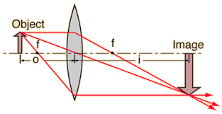
Lens Diagram Terminology
Object: Thing being refracted through lens
Image: What the object is seen as
Real Image: The light comes from “real” rays
Virtual Image: Comes from rays that aren't there
Principal axis: Line perpendicular to the lens through the center of the lens
Lens diagrams will often include 2f as well is f. 2f is very important as well.
Size?

Slide 26
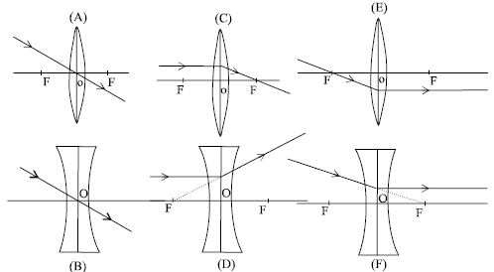
Rules of Lens Diagrams
Principal axis: Line perpendicular to the lens through the center of the lens
Rays Parallel to the Principal axis will pass through the focus
Rays passing through the focus will become parallel to the principal axis
Rays passing through the center will not change direction

Slide 27
Converging lenses

Slide 28
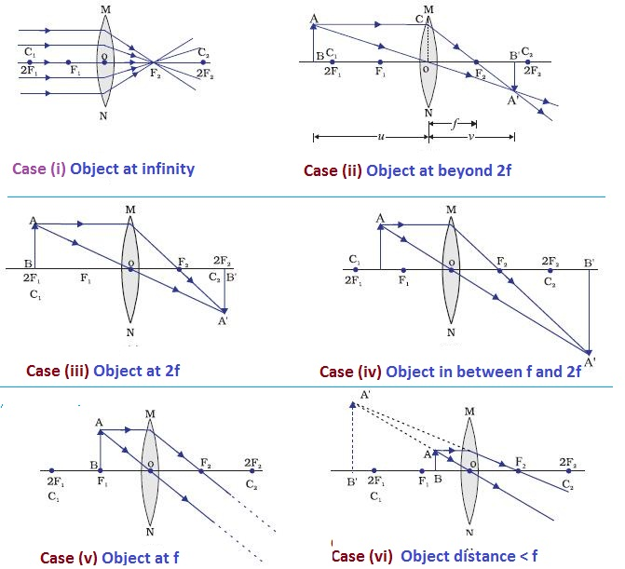
Cases of Lenses 1
Case 1: Object at infinity
Since the object is at infinity, rule 1 applies to all of the light
All light must converge to the focus
Image is non existent since it has size 0

Slide 29
Cases of Lenses 2
Object is between infinity and 2f
Ray perpendicular goes through focus
Ray through center goes straight through
Ray through focus goes parallel
Smaller image
Flipped image

Slide 30
Cases of Lenses 3
Object is at 2f
Ray perpendicular goes through focus
Ray through center goes straight through
Ray through focus goes parallel
Same size!
Flipped image

Slide 31
Cases of Lenses 4
Object is between f and 2f
Ray perpendicular goes through focus
Ray through center goes straight through
Ray through focus goes parallel
Increased size!
Flipped image

Slide 32
Cases of Lenses 5
Object is at f
Ray perpendicular goes through focus
Ray through center goes straight through
Ray through focus goes parallel
No image!

Slide 33
Cases of Lenses 6
Object is between the lens and f
Ray perpendicular goes through focus
Ray through center goes straight through
Ray through focus goes parallel
Image is formed on the same side as the object!
Virtual image
Not Flipped

Slide 34
Diverging lenses

Slide 35
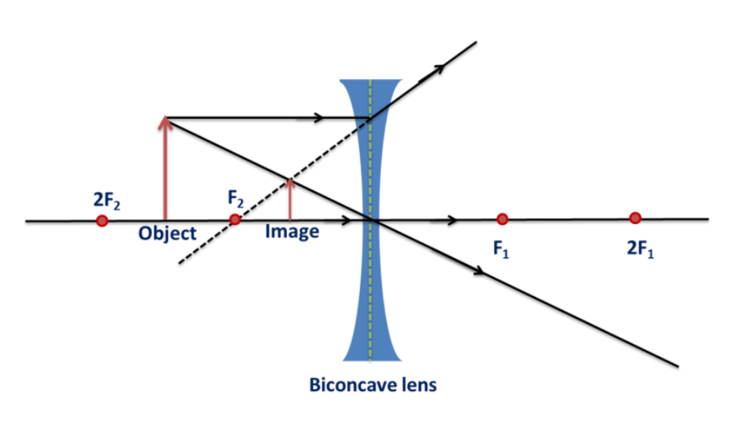
Cases of Lenses 1
Literally the only cases lulw
Image always virtual and smaller
If all the rays come from infinity, no rays go through the center
Image is a point at F2
The closer the object gets, the larger the image becomes, and the location of the image gets closer to the lens

Slide 36
Review
What is a lens?
What is the focus of the lens?
Why do lenses bend light?
If an object is at exactly 2f…
How large is the image compared to the object?
Is the image real or virtual?
Is the image flipped or not flipped?

